Slide 1
ENEL 419
Bivariate Random Variables
(Reading Exercises: Montgomery and Runger – Chapter 5; Yates and Goodman – Chapter 5)

Slide 2
Bivariate Random Variables
In electrical engineering, we often want to investigate the joint behavior of multiple random variables.
In circuit analyses, we may want to study the properties of voltages at different stages of the circuit in response to a random input voltage
The focus in this course, however, is on bivariate (two) random variables.
In order to study the joint behavior of two random variables we need to study their joint probability distributions.

Slide 3
Learning Outcomes
Be able to do the following:
Define a joint probability density function of two random variables.
Use a joint probability density function to find the probability of events.
Find marginal probability density functions of two random variables.
Apply the conditions for independence to two random variables
Evaluate mathematical expectations of two random variables.
Evaluate mathematical expectations of functions of two random variables.
Compute the covariance and the correlation coefficient.

Slide 4
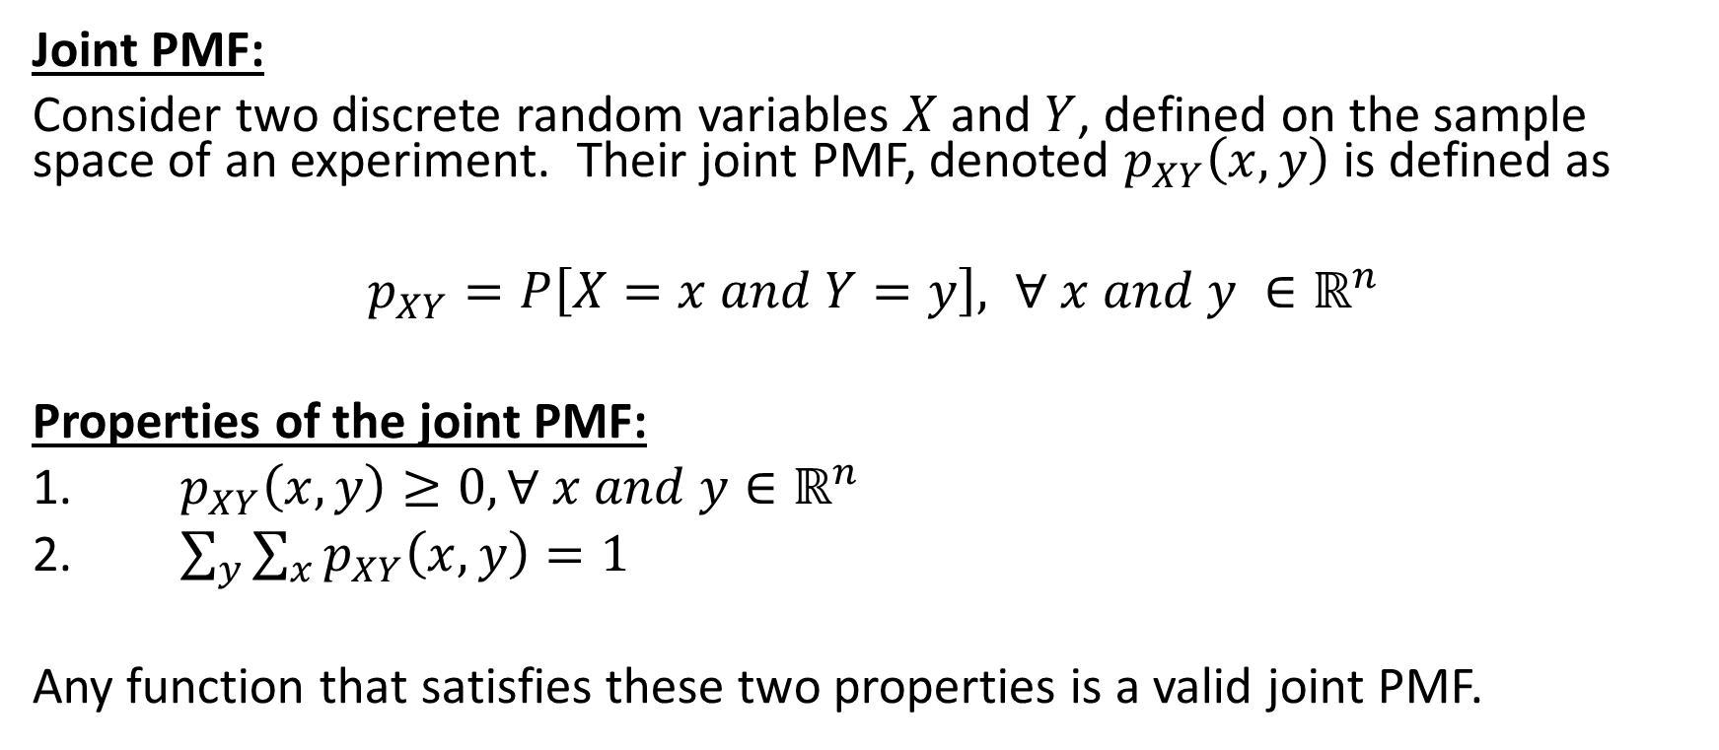
Joint Probability Distribution of Discrete Random Variables
Joint PMF:
Consider two discrete random variables $X$ and $Y$, defined on the sample space of an experiment. Their joint PMF, denoted $p_{XY}\left(x,y\right)$ is defined as
$p_{XY}=P\left[X=x and Y=y\right], ∀ x and y ∈ℝ^{n}$
Properties of the joint PMF:
1. $p_{XY}\left(x,y\right)≥0, ∀ x and y∈ℝ^{n}$
2. $\sum_{y}{\sum_{x}{p_{XY}\left(x,y\right)=1}}$
Any function that satisfies these two properties is a valid joint PMF.

Slide 5
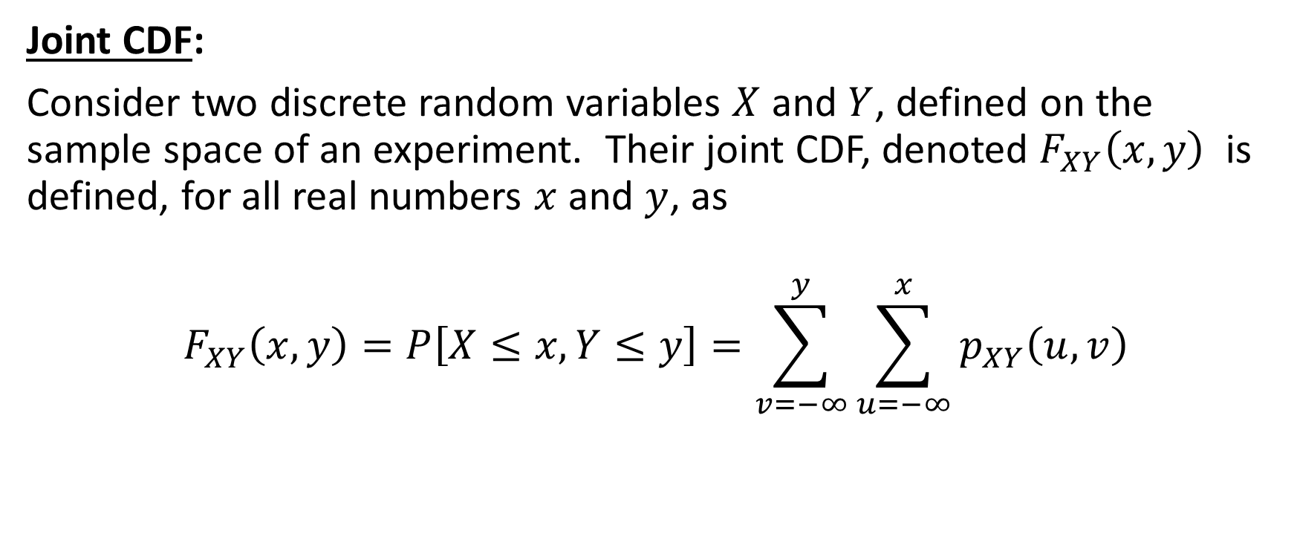
Joint Probability Distribution of Discrete Random Variables
Joint CDF:
Consider two discrete random variables $X$ and $Y$, defined on the sample space of an experiment. Their joint CDF, denoted $F_{XY}\left(x,y\right)$ is defined, for all real numbers $x$ and $y$, as
$$F_{XY}\left(x,y\right)=P\left[X≤x, Y≤y\right]=\sum_{v=−∞}^{y}{\sum_{u=−∞}^{x}{p_{XY}\left(u,v\right)}}$$

Slide 6

Example 1
For the joint PMF in the table below, calculate the probability $P\left[X+Y≤2\right]$
Solution:
$$P\left[X+Y≤2\right]=P\left[X=0, Y=1\right]+P\left[X=0, Y=2\right]+P\left[X=1,Y=1\right]$$
$$=0.09+0.05+0.06=0.2$$

Slide 7
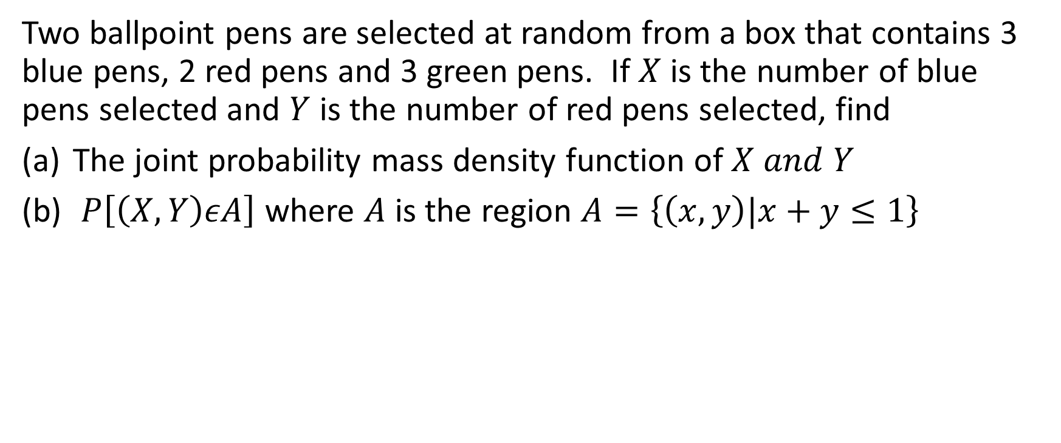
Example 2
Two ballpoint pens are selected at random from a box that contains 3 blue pens, 2 red pens and 3 green pens. If $X$ is the number of blue pens selected and $Y$ is the number of red pens selected, find
The joint probability mass density function of $X and Y$
$P\left[\left(X,Y\right)εA\right]$ where $A$ is the region $A=\left\{\left(x,y\right)|x+y≤1\right\}$

Slide 8
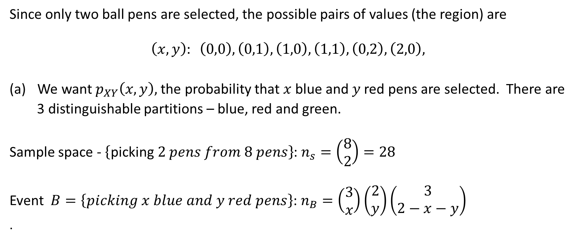
Example 2 Solutions
Since only two ball pens are selected, the possible pairs of values (the region) are
$$\left(x,y\right): \left(0,0\right), \left(0,1\right), \left(1,0\right),\left(1,1\right), \left(0,2\right), \left(2,0\right),$$
We want $p_{XY}\left(x,y\right),$ the probability that $x$ blue and $y$ red pens are selected. There are
3 distinguishable partitions – blue, red and green.
Sample space - $\left\{\text{picking} 2 pens from 8 pens\right\}$: $n_{s}=\left(\begin{aligned}8 \\ 2\end{aligned}\right)=28$
Event $B=\left\{picking x blue and y red pens\right\}$: $n_{B}=\left(\begin{aligned}3 \\ x\end{aligned}\right)\left(\begin{aligned}2 \\ y\end{aligned}\right)\left(\begin{aligned}3 \\ 2−x−y\end{aligned}\right)$
.

Slide 9
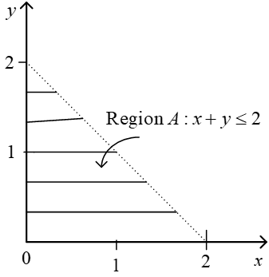
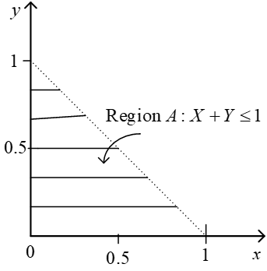

Example 2 Solutions continued
$$p_{XY}\left(x,y\right)=\frac{n_{B}}{n_{s}}=\frac{\left(\begin{aligned}3 \\ x\end{aligned}\right)\left(\begin{aligned}2 \\ y\end{aligned}\right)\left(\begin{aligned}3 \\ 2−x−y\end{aligned}\right)}{28}, x=0, 1, 2; y=0, 1, 2⇒x+y≤2$$
(b) $P\left[X+Y≤1\right]=P\left[0,0\right]+P\left[0,1\right]+P\left[1,0\right]=\frac{9}{14}$

Slide 10
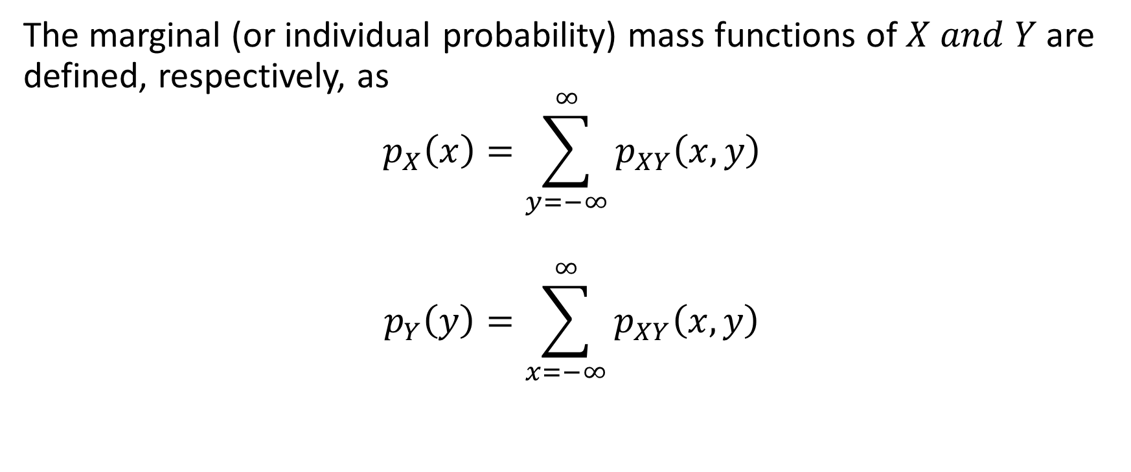
Marginal Probability Mass Functions
The marginal (or individual probability) mass functions of $X and Y$ are defined, respectively, as
$$p_{X}\left(x\right)=\sum_{y=−∞}^{∞}{p_{XY}\left(x,y\right)}$$
$$p_{Y}\left(y\right)=\sum_{x=−∞}^{∞}{p_{XY}\left(x,y\right)}$$

Slide 11

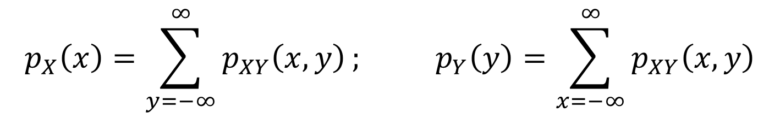
Example 3
Find the marginal PMFs of the random variables $X and Y$ for the joint PMF given by the table below.
$$p_{X}\left(x\right)=\sum_{y=−∞}^{∞}{p_{XY}\left(x,y\right)}; p_{Y}\left(y\right)=\sum_{x=−∞}^{∞}{p_{XY}\left(x,y\right)}$$

Slide 12
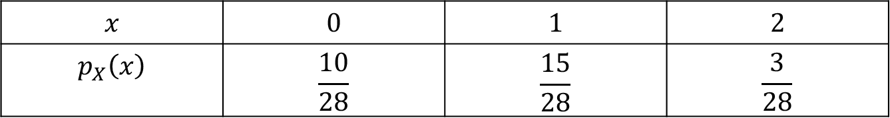

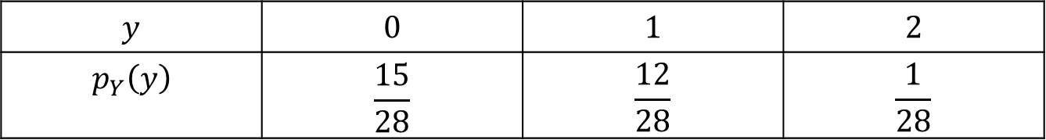
Example 3 Solutions
$$p_{X}\left(x\right)=\sum_{y=−∞}^{∞}{p_{XY}\left(x,y\right);p_{Y}\left(y\right)=\sum_{x=−∞}^{∞}{p_{XY}\left(x,y\right)}}$$
$$x$$ | $$0$$ | $$1$$ | $$2$$
$$p_{X}\left(x\right)$$ | $$\frac{10}{28}$$ | $$\frac{15}{28}$$ | $$\frac{3}{28}$$
$$y$$ | $$0$$ | $$1$$ | $$2$$
$$p_{Y}\left(y\right)$$ | $$\frac{15}{28}$$ | $$\frac{12}{28}$$ | $$\frac{1}{28}$$

Slide 13
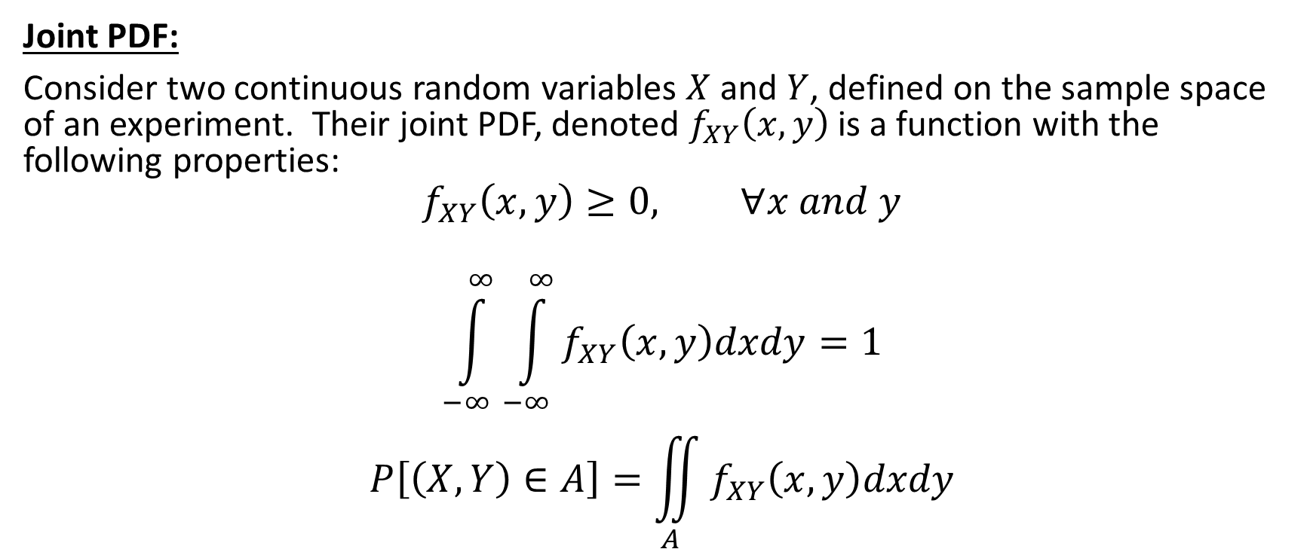
Joint Probability Distribution of Continuous Random Variables
Joint PDF:
Consider two continuous random variables $X$ and $Y$, defined on the sample space of an experiment. Their joint PDF, denoted $f_{XY}\left(x,y\right)$ is a function with the following properties:
$$f_{XY}\left(x,y\right)≥0, ∀x and y$$
$$\int_{−∞}^{∞}{\int_{−∞}^{∞}{f_{XY}\left(x,y\right)dxdy=1}}$$
$$P\left[\left(X,Y\right)∈A\right]=\iint_{A}{f_{XY}\left(x,y\right)dxdy}$$

Slide 14
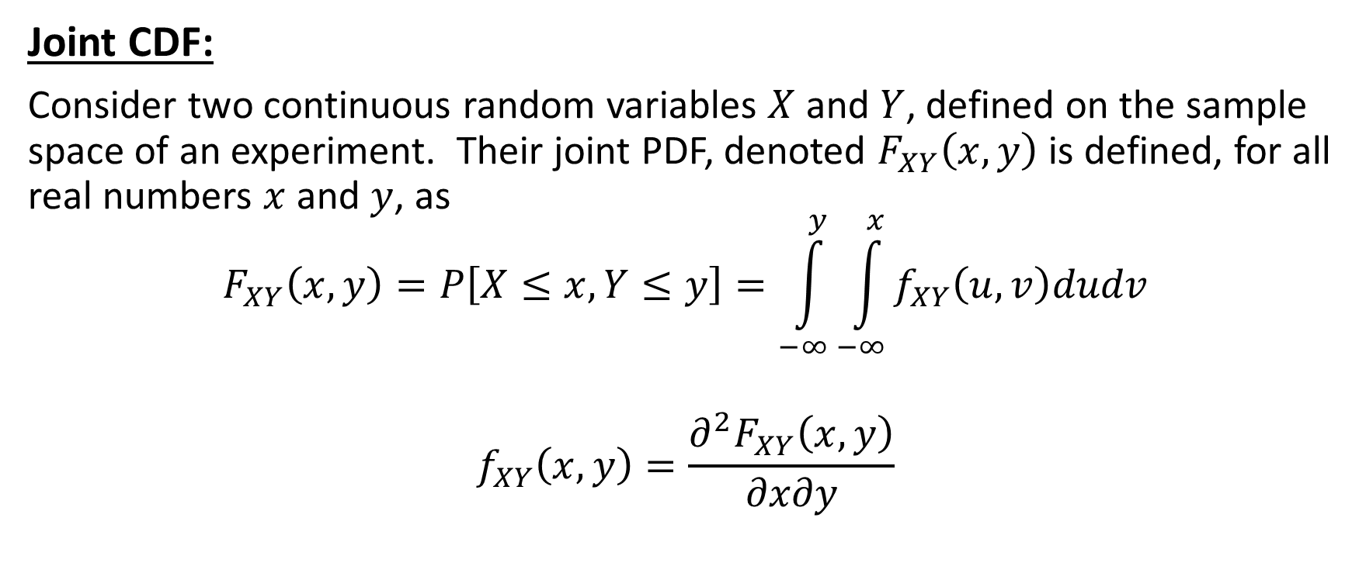
Joint Probability Distribution of Continuous Random Variables
Joint CDF:
Consider two continuous random variables $X$ and $Y$, defined on the sample space of an experiment. Their joint PDF, denoted $F_{XY}\left(x,y\right)$ is defined, for all real numbers $x$ and $y$, as
$$F_{XY}\left(x,y\right)=P\left[X≤x, Y≤y\right]=\int_{−∞}^{y}{\int_{−∞}^{x}{f_{XY}\left(u,v\right)dudv}}$$
$$f_{XY}\left(x,y\right)=\frac{∂^{2}F_{XY}\left(x,y\right)}{∂x∂y}$$

Slide 15
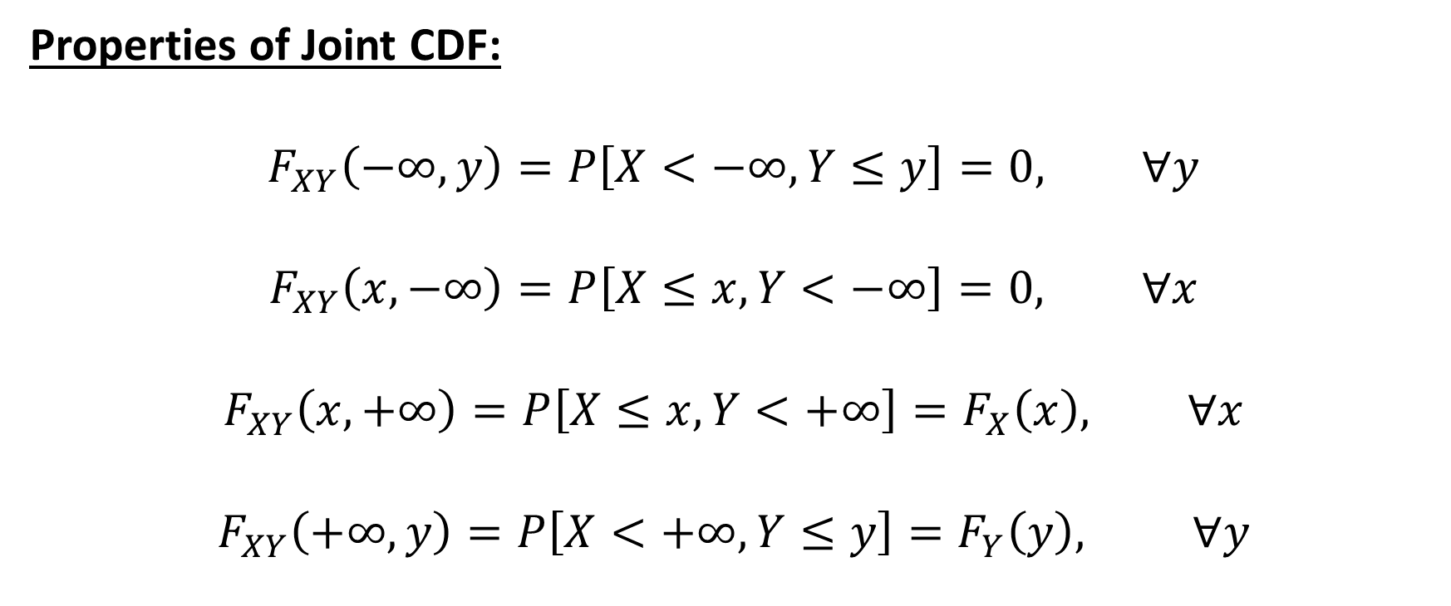
Joint Probability Distribution of Continuous Random Variables
Properties of Joint CDF:
$$F_{XY}\left(−∞,y\right)=P\left[X<−∞, Y≤y\right]=0, ∀y$$
$$F_{XY}\left(x,−∞\right)=P\left[X≤x, Y<−∞\right]=0, ∀x$$
$$F_{XY}\left(x,+∞\right)=P\left[X≤x, Y<+∞\right]=F_{X}\left(x\right), ∀x$$
$$F_{XY}\left(+∞,y\right)=P\left[X<+∞, Y≤y\right]=F_{Y}\left(y\right), ∀y$$

Slide 16
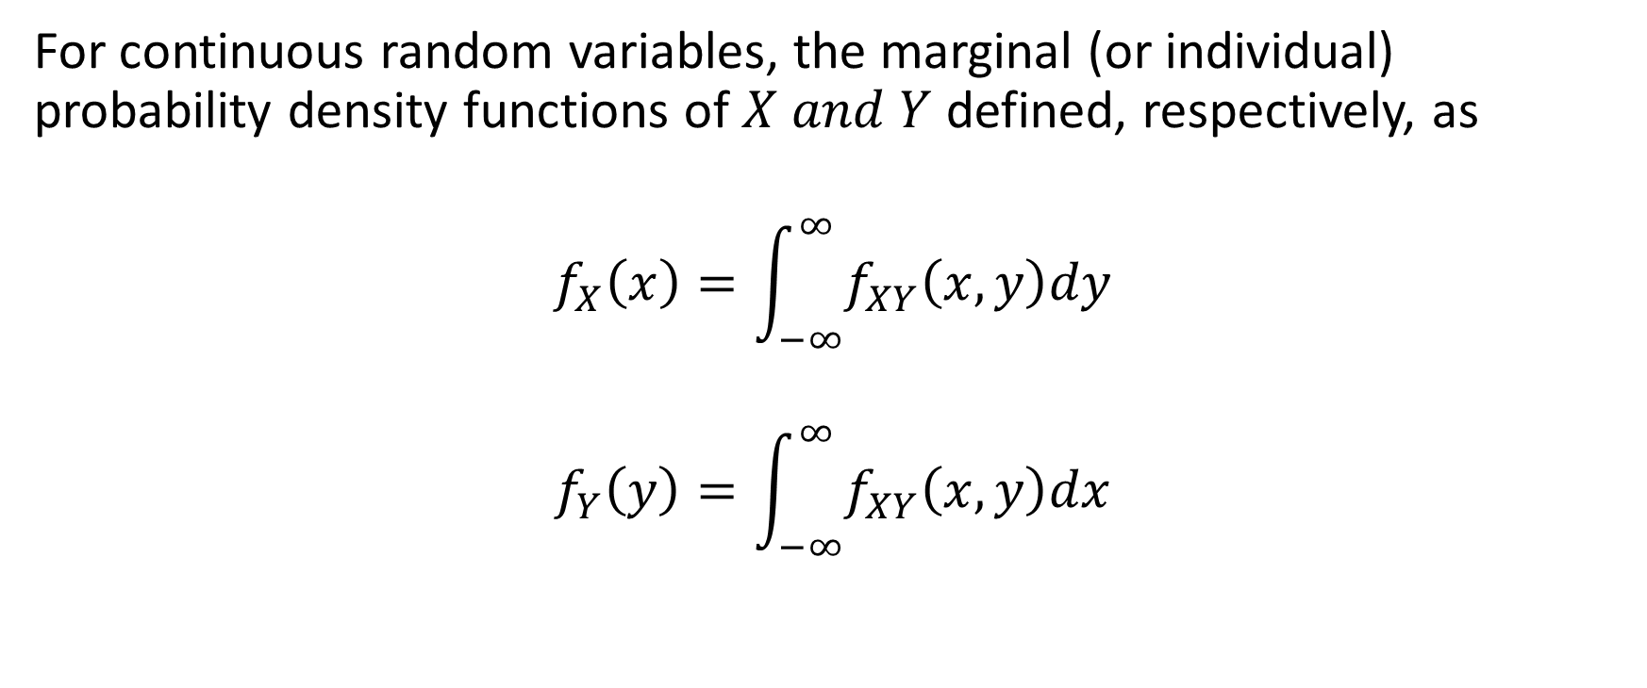
Marginal Probability Density Functions
For continuous random variables, the marginal (or individual) probability density functions of $X and Y$ defined, respectively, as
$$f_{X}\left(x\right)=\int_{−∞}^{∞}{f_{XY}\left(x,y\right)dy}$$
$$f_{Y}\left(y\right)=\int_{−∞}^{∞}{f_{XY}\left(x,y\right)dx}$$

Slide 17
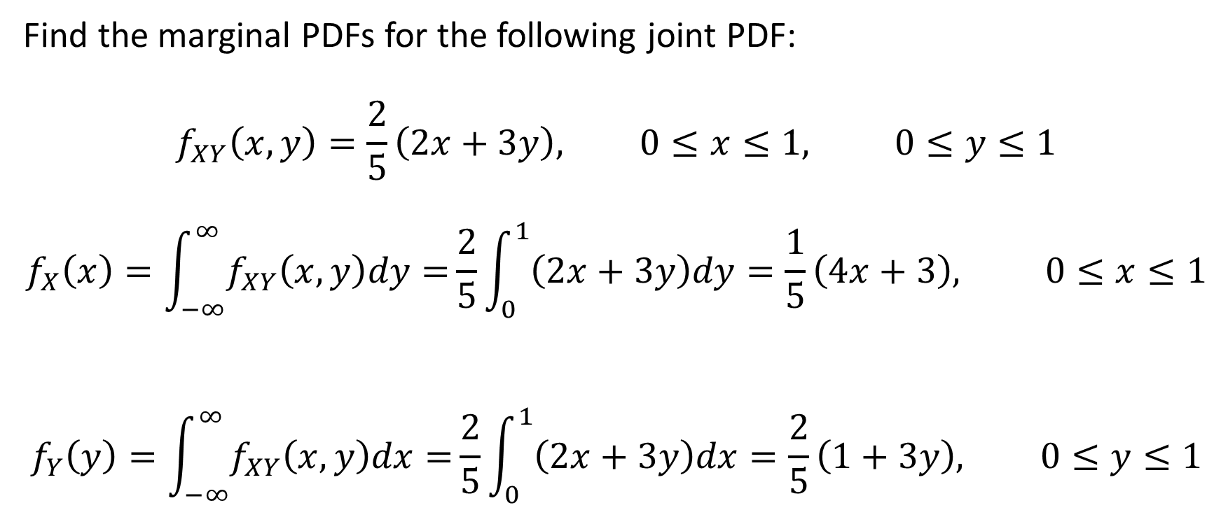
Example 4
Find the marginal PDFs for the following joint PDF:
$$f_{XY}\left(x,y\right)=\frac{2}{5}\left(2x+3y\right), 0≤x≤1, 0≤y≤1$$
$$f_{X}\left(x\right)=\int_{−∞}^{∞}{f_{XY}\left(x,y\right)dy=}\frac{2}{5}\int_{0}^{1}{\left(2x+3y\right)dy}=\frac{1}{5}\left(4x+3\right), 0≤x≤1$$
$$f_{Y}\left(y\right)=\int_{−∞}^{∞}{f_{XY}\left(x,y\right)dx=}\frac{2}{5}\int_{0}^{1}{\left(2x+3y\right)dx}=\frac{2}{5}\left(1+3y\right), 0≤y≤1$$

Slide 18
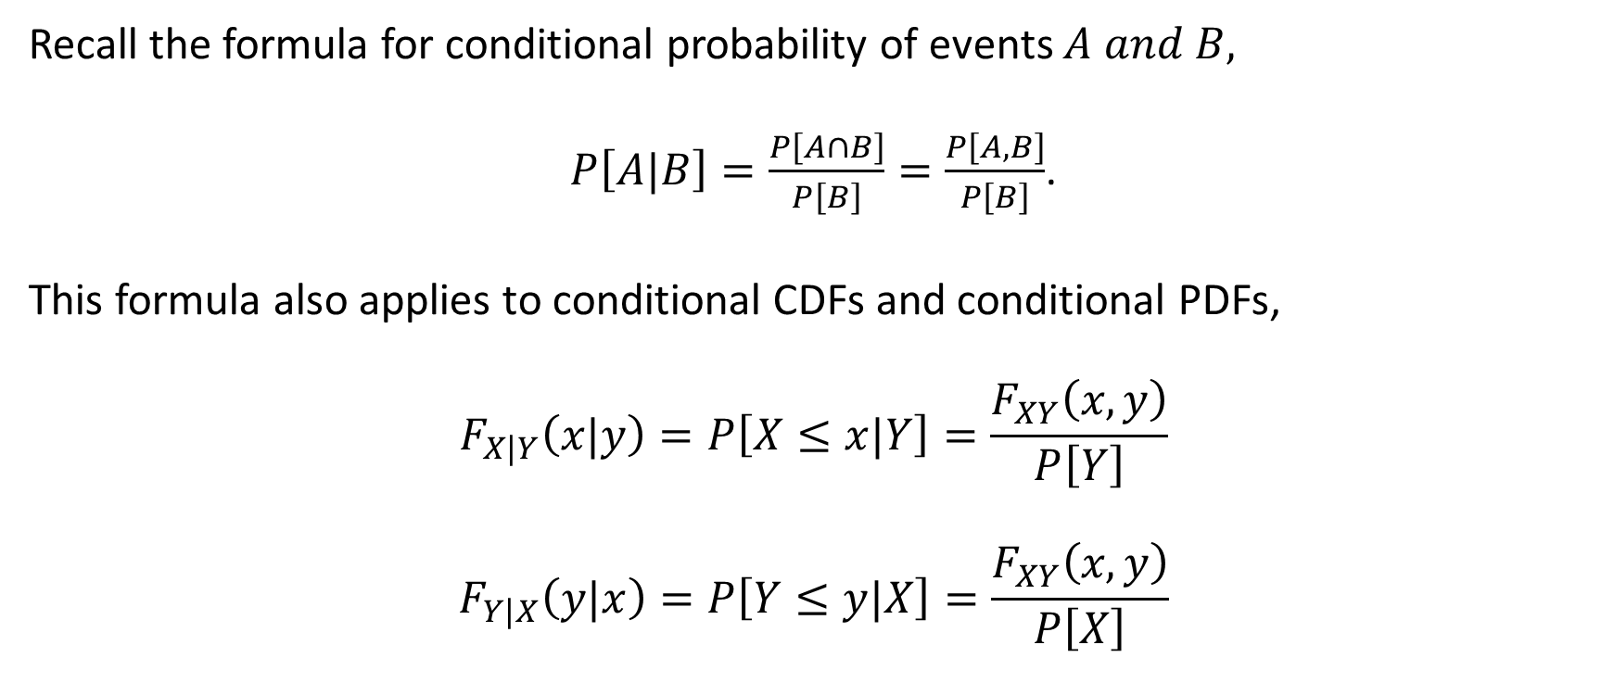
Conditional CDFs
Recall the formula for conditional probability of events $A and B,$
$P\left[A|B\right]=\frac{P\left[A∩B\right]}{P\left[B\right]}=\frac{P\left[A,B\right]}{P\left[B\right]}$.
This formula also applies to conditional CDFs and conditional PDFs,
$$F_{X|Y}\left(x|y\right)=P\left[X≤x|Y\right]=\frac{F_{XY}\left(x,y\right)}{P\left[Y\right]}$$
$$F_{Y|X}\left(y|x\right)=P\left[Y≤y|X\right]=\frac{F_{XY}\left(x,y\right)}{P\left[X\right]}$$

Slide 19
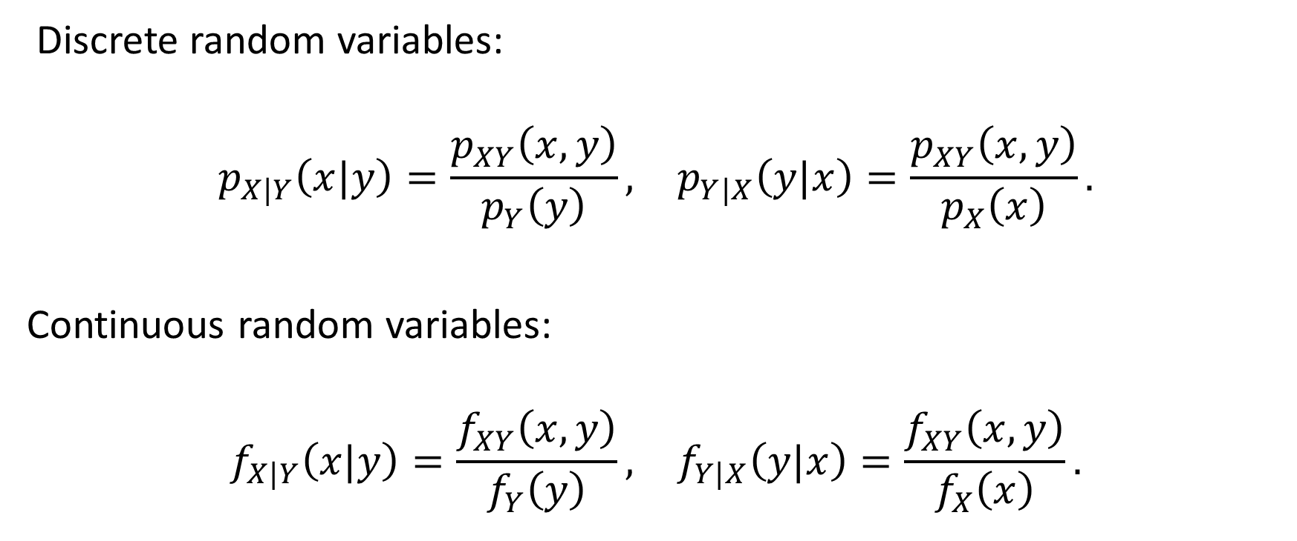
Conditional PDFs and Conditional PMFs
Discrete random variables:
$$\begin{matrix}p_{X|Y}\left(x|y\right)=\frac{p_{XY}\left(x,y\right)}{p_{Y}\left(y\right)}, & p_{Y|X}\left(y|x\right)=\frac{p_{XY}\left(x,y\right)}{p_{X}\left(x\right)}.\end{matrix}$$
Continuous random variables:
$$\begin{matrix}f_{X|Y}\left(x|y\right)=\frac{f_{XY}\left(x,y\right)}{f_{Y}\left(y\right)}, & f_{Y|X}\left(y|x\right)=\frac{f_{XY}\left(x,y\right)}{f_{X}\left(x\right)}.\end{matrix}$$

Slide 20

Example 5
Use the table below to find the conditional PMF of $X$ given that $Y=1$ and use it to find the conditional probability $P\left[X=0|Y=1\right].$

Slide 21

Example 5 Solutions
$${ p}_{X|1}\left(x|1\right)=\frac{p_{XY}\left(x,1\right)}{p_{Y}\left(1\right)}$$
$$p_{Y}\left(1\right)=\sum_{x=0}^{2}{p_{XY}\left(x,1\right)}=\frac{3}{14}+\frac{3}{14}=\frac{3}{7}$$
$$p_{X|1}\left(x|1\right)=\frac{p_{XY}\left(x,1\right)}{p_{Y}\left(1\right)}=\frac{7}{3}×p_{XY}\left(x,1\right)$$

Slide 22

Example 5 Solutions
$$P\left[X=0|Y=1\right]=\frac{p_{XY}\left(0,1\right)}{p_{Y}\left(1\right)}=\frac{7}{3}×\frac{3}{14}=\frac{1}{2}$$

Slide 23

Example 6
For the joint PDF
Find the conditional probability
$$P\left[Y>\frac{1}{2}|X=\frac{1}{4}\right]$$

Slide 24
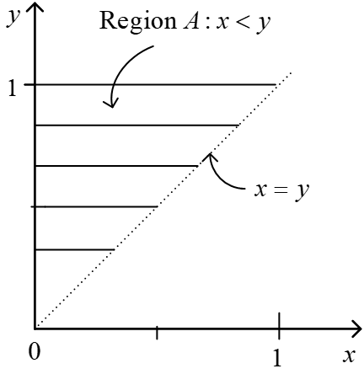

Example 6 Solutions
$$0<x<y<1$$
$$f_{X}\left(x\right)=10\int_{x}^{1}{xy^{2}dy=\frac{10}{3}}x\left(1−x^{3}\right), 0<x<1$$
$$f_{Y}\left(y\right)=10\int_{0}^{y}{xy^{2}dx=5}y^{4}, 0<y<1$$
$$f_{Y|X}\left(y|x\right)=\frac{f_{XY}(x,y)}{f_{X}(x)}=\frac{10xy^{2}}{\frac{10}{3}x\left(1−x^{3}\right)}=\frac{3y^{2}}{1−x^{3}}$$

Slide 25

Example 6 Solutions
$$f_{Y|X}\left(y|x\right)=\frac{3y^{2}}{1−x^{3}}, (0<x<y<1)$$
$$P\left[Y>1/2|X=1/4\right]=\int_{1/2}^{1}{f_{Y|X}\left(y|x=1/4\right)dy}$$
$$=\int_{1/2}^{1}{\frac{3y^{2}dy}{1−{\left(1/4\right)}^{3}}=}\frac{8}{9}$$

Slide 26
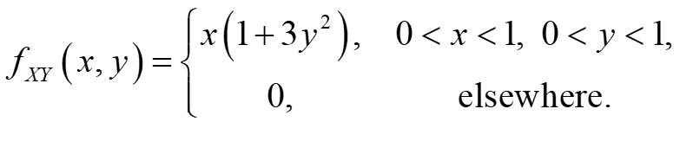
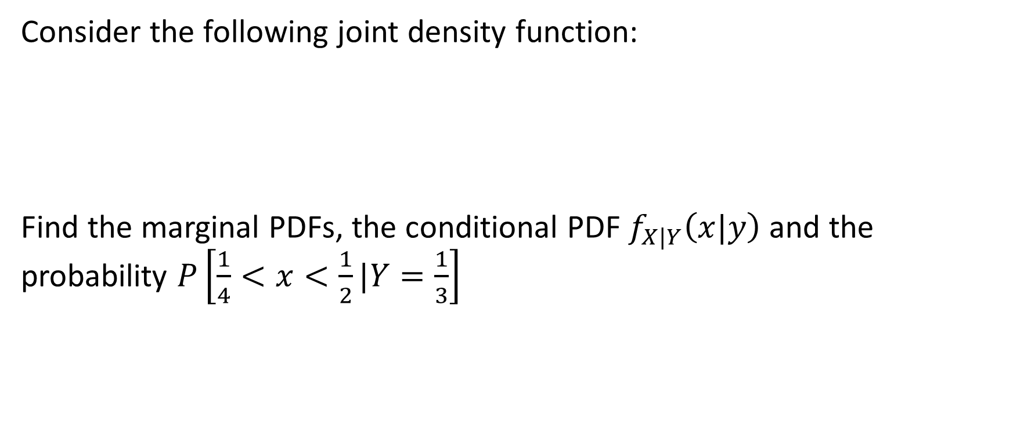
Example 7
Consider the following joint density function:
Find the marginal PDFs, the conditional PDF $f_{X|Y}\left(x|y\right)$ and the probability $P\left[\frac{1}{4}<x<\frac{1}{2}|Y=\frac{1}{3}\right]$

Slide 27
Example 7 Solutions

Slide 28

Conditional Expectations
If $X and Y$ are two random variables, the conditional expectations are defined as
$$E\left[X|Y=y\right]=\int_{−∞}^{∞}{xf_{X|Y}\left(x|y\right)dx,}$$
$$E\left[Y|X=x\right]=\int_{−∞}^{∞}{yf_{X|Y}\left(y|x\right)dy. }$$
$$E\left[X|Y=y\right]=\sum_{x}{xp_{X|Y}\left(x|y\right),}$$
$$E\left[Y|X=x\right]=\sum_{x}{yp_{Y|X}\left(y|x\right).}$$

Slide 29
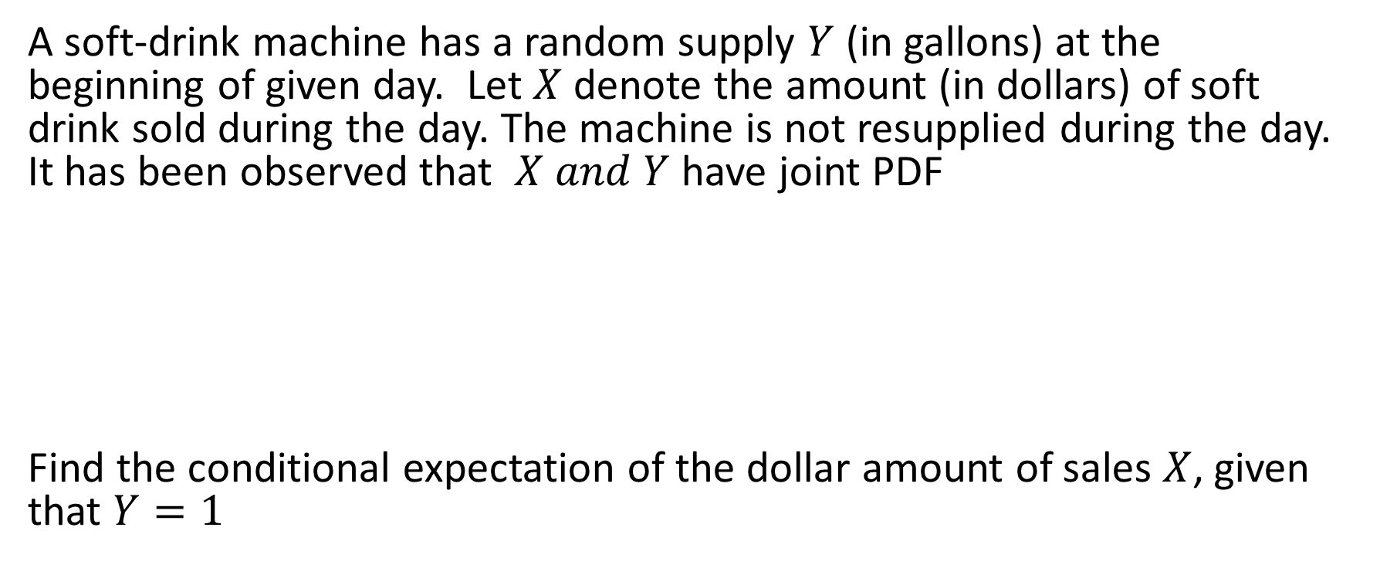
Example 8
A soft-drink machine has a random supply $Y$ (in gallons) at the beginning of given day. Let $X$ denote the amount (in dollars) of soft drink sold during the day. The machine is not resupplied during the day. It has been observed that $X and Y$ have joint PDF
Find the conditional expectation of the dollar amount of sales $X$, given that $Y=1$

Slide 30

Example 8 Solutions
$$f_{Y}\left(y\right)=\int_{0}^{y}{\frac{1}{2}dx=\frac{y}{2}}$$
$$f_{X|Y}\left(x|y\right)=\frac{f_{XY}\left(x,y\right)}{f_{Y}\left(y\right)}=\frac{1}{y}$$
$$f_{X|Y}\left(x|y\right)=\left\{\begin{aligned}\frac{1}{y}, 0<x<y<2 \\ &0, otherwise\end{aligned}\right.$$

Slide 31

Example 8 Solutions
For $Y=1$
$$f_{X|Y}\left(x|y\right)=\left\{\begin{aligned}1, 0<x<1 \\ &0, otherwise\end{aligned}\right.$$
$$E\left[X|Y=1\right]=\int_{−∞}^{∞}{xf_{X|Y}\left(x|y\right)dx=\int_{0}^{1}{xdx=\frac{1}{2}}}$$

Slide 32
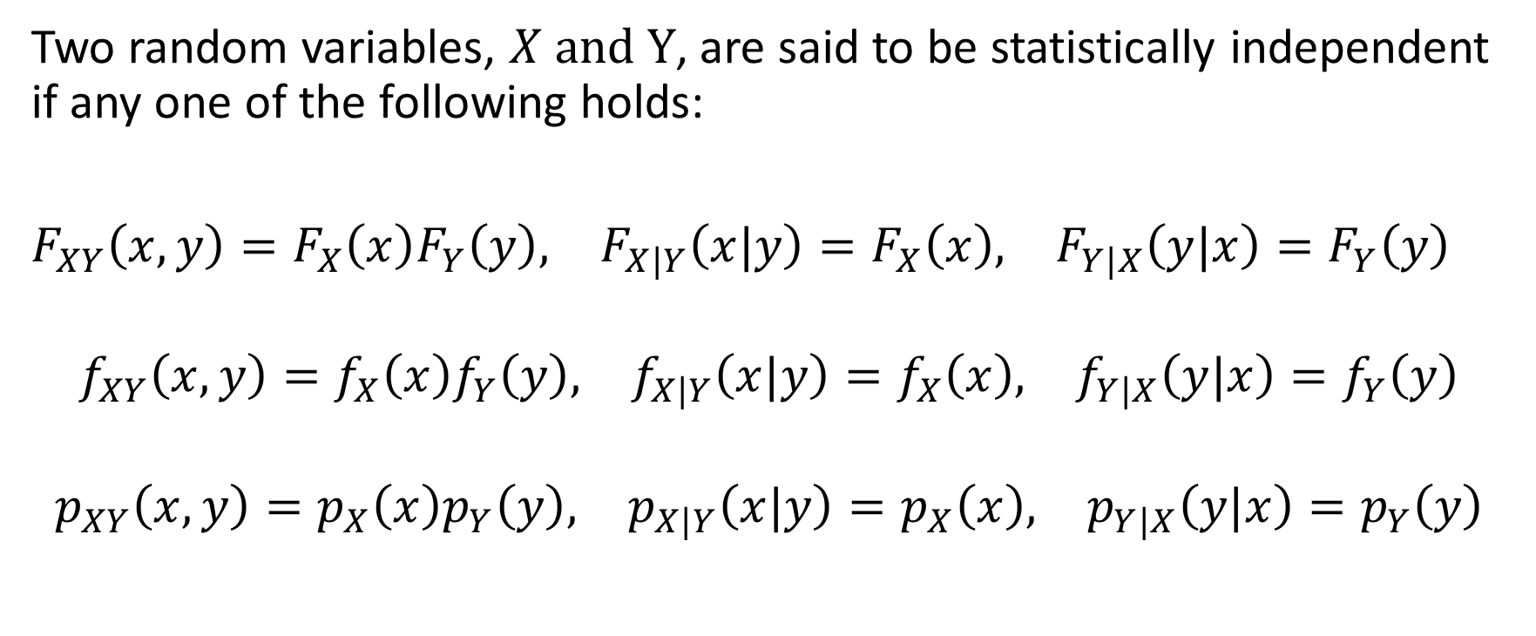
Independence of Random Variables and Functions
Two random variables, $X and Y$, are said to be statistically independent if any one of the following holds:
$\begin{matrix}F_{XY}\left(x,y\right)=F_{X}\left(x\right)F_{Y}\left(y\right), & F_{X|Y}\left(x|y\right)=F_{X}\left(x\right), & F_{Y|X}\left(y|x\right)=F_{Y}\left(y\right)\end{matrix}$
$$\begin{matrix}f_{XY}\left(x,y\right)=f_{X}\left(x\right)f_{Y}\left(y\right), & f_{X|Y}\left(x|y\right)=f_{X}\left(x\right), & f_{Y|X}\left(y|x\right)=f_{Y}\left(y\right)\end{matrix}$$
$$\begin{matrix}p_{XY}\left(x,y\right)=p_{X}\left(x\right)p_{Y}\left(y\right), & p_{X|Y}\left(x|y\right)=p_{X}\left(x\right), & p_{Y|X}\left(y|x\right)=p_{Y}\left(y\right)\end{matrix}$$

Slide 33
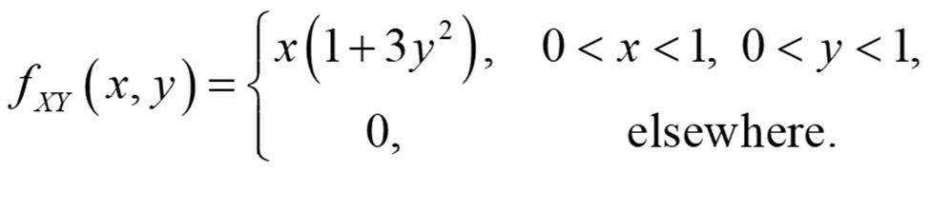

Example 9
Consider the following joint density function:
Show that random variables $X and Y$ are independent. That is,
$$f_{XY}\left(x,y\right)=f_{X}(x)f_{Y}(y)$$

Slide 34
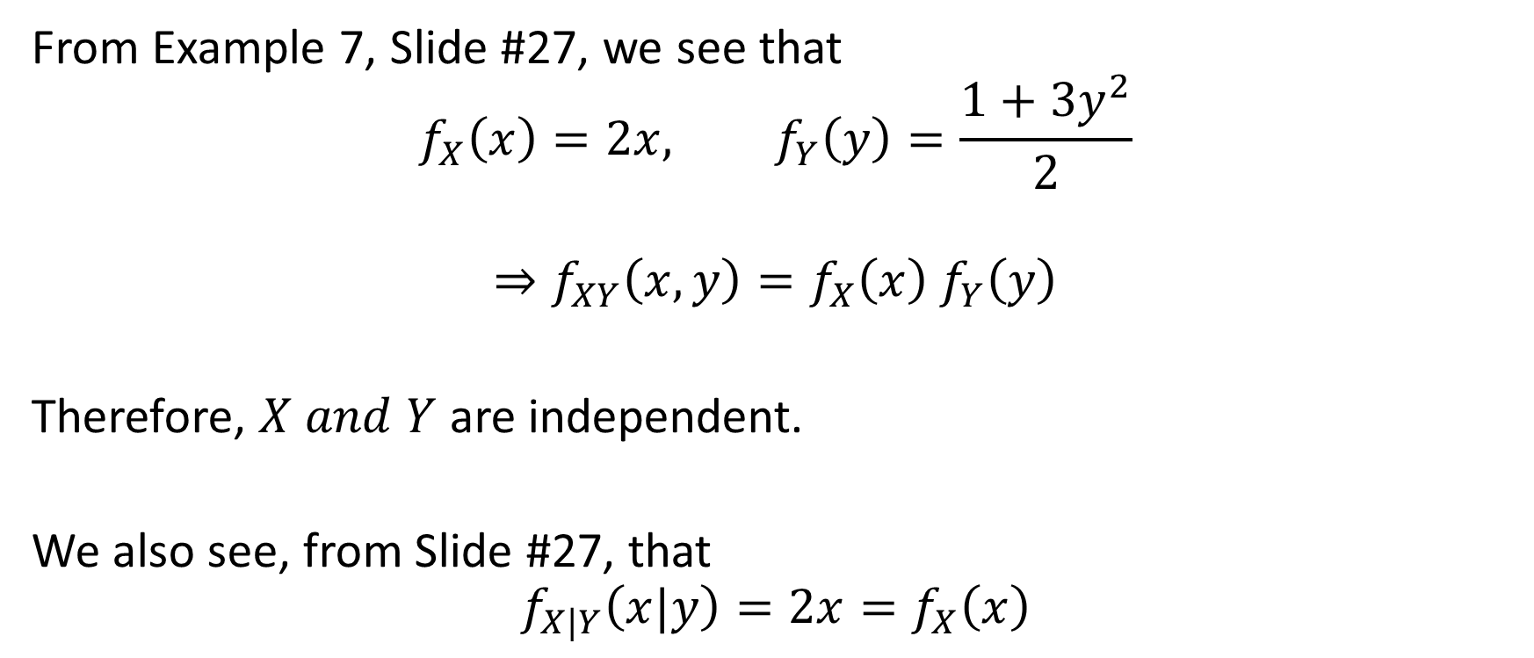
Example 9 Solution
From Example 7, Slide #27, we see that
$$f_{X}\left(x\right)=2x, f_{Y}\left(y\right)=\frac{1+3y^{2}}{2}$$
$$⇒f_{XY}\left(x,y\right)=f_{X}\left(x\right) f_{Y}\left(y\right)$$
Therefore, $X and Y$ are independent.
We also see, from Slide #27, that
$$f_{X|Y}\left(x|y\right)=2x=f_{X}\left(x\right)$$

Slide 35
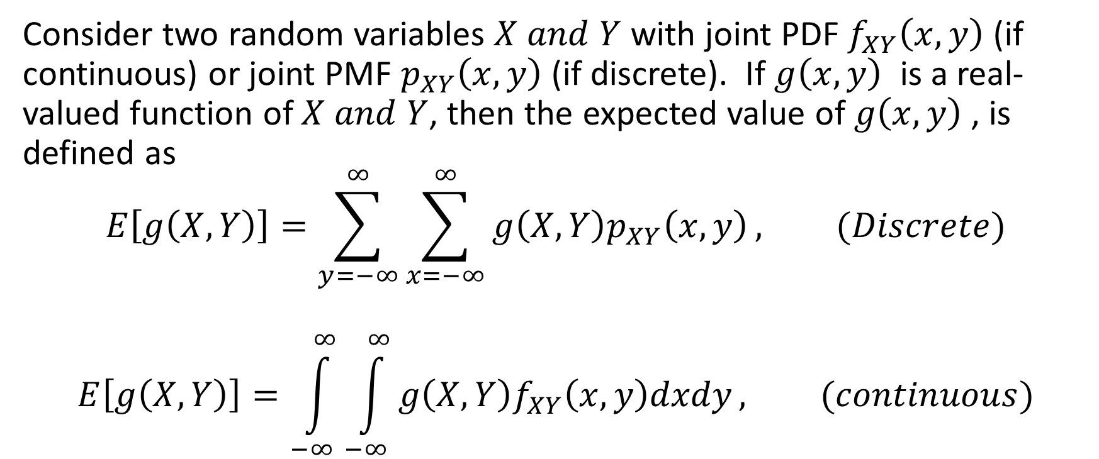
Expected Values of Functions of Bivariate Random Variables
Consider two random variables $X and Y$ with joint PDF$f_{XY}\left(x,y\right)$ (if continuous) or joint PMF $p_{XY}\left(x,y\right)$ (if discrete). If $g\left(x,y\right)$ is a real-valued function of $X and Y$, then the expected value of $g\left(x,y\right)$ , is defined as
$$E\left[g\left(X,Y\right)\right]=\sum_{y=−∞}^{∞}{\sum_{x=−∞}^{∞}{g\left(X,Y\right)p_{XY}\left(x,y\right)}}, (Discrete)$$
$$E\left[g\left(X,Y\right)\right]=\int_{−∞}^{∞}{\int_{−∞}^{∞}{g\left(X,Y\right)f_{XY}\left(x,y\right)dxdy}}, (continuous)$$

Slide 36
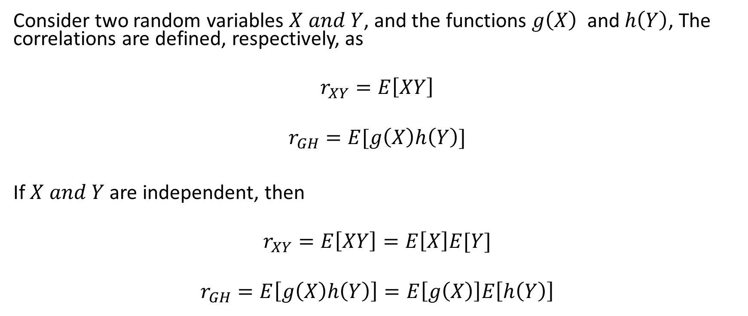
Correlation
Consider two random variables $X and Y$, and the functions $g\left(X\right)$ and $h\left(Y\right)$, The correlations are defined, respectively, as
$$r_{XY}=E\left[XY\right]$$
$$r_{GH}=E[g\left(X\right)h\left(Y\right)]$$
If $X and Y$ are independent, then
$$r_{XY}=E\left[XY\right]=E\left[X\right]E[Y]$$
$$r_{GH}=E\left[g\left(X\right)h\left(Y\right)\right]=E\left[g\left(X\right)\right]E\left[h\left(Y\right)\right]$$

Slide 37
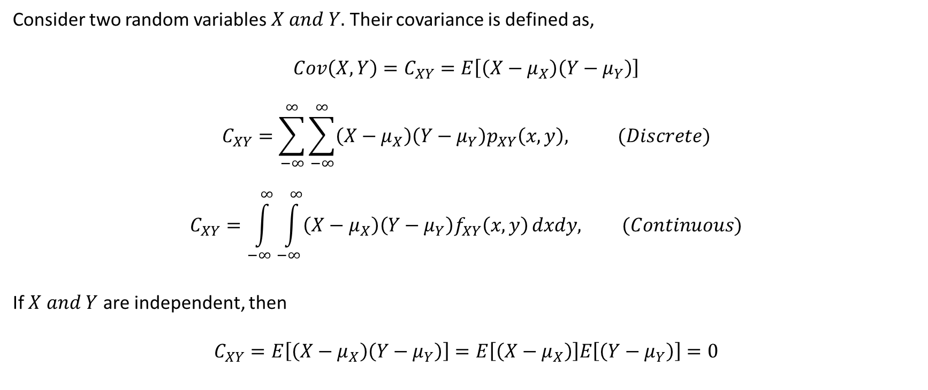
Covariance
Consider two random variables $X and Y.$ Their covariance is defined as,
$$Cov\left(X,Y\right)=C_{XY}=E\left[\left(X−μ_{X}\right)\left(Y−μ_{Y}\right)\right]$$
$$C_{XY}=\sum_{−∞}^{∞}{\sum_{−∞}^{∞}{\left(X−μ_{X}\right)\left(Y−μ_{Y}\right)p_{XY}\left(x,y\right), (Discrete)}}$$
$$C_{XY}=\int_{−∞}^{∞}{\int_{−∞}^{∞}{\left(X−μ_{X}\right)\left(Y−μ_{Y}\right)f_{XY}\left(x,y\right)}}dxdy, (Continuous)$$
If $X and Y$ are independent, then
$$C_{XY}=E\left[\left(X−μ_{X}\right)\left(Y−μ_{Y}\right)\right]=E\left[\left(X−μ_{X}\right)\right]E\left[\left(Y−μ_{Y}\right)\right]=0$$

Slide 38
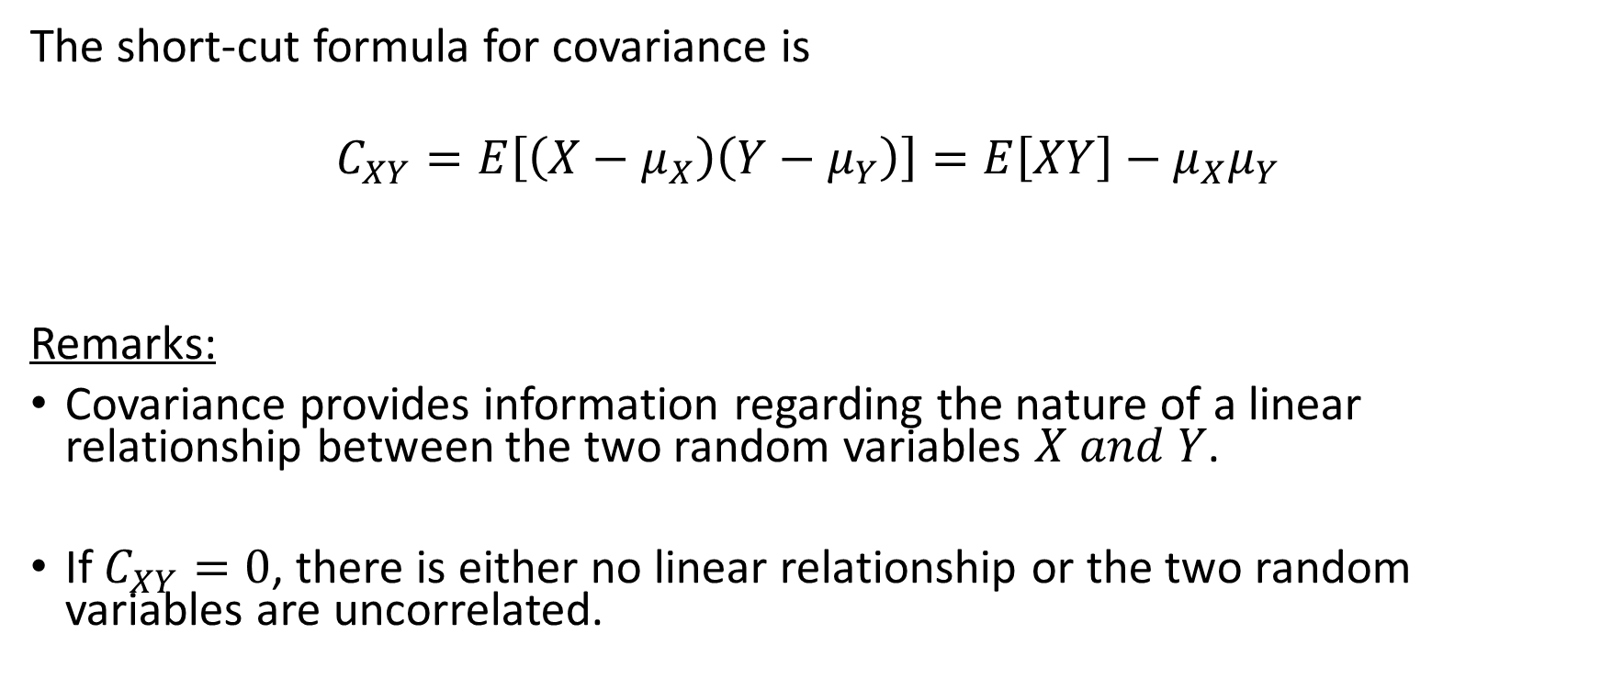
Covariance
The short-cut formula for covariance is
$$C_{XY}=E\left[\left(X−μ_{X}\right)\left(Y−μ_{Y}\right)\right]=E\left[XY\right]−{μ_{X}μ}_{Y}$$
Remarks:
Covariance provides information regarding the nature of a linear relationship between the two random variables $X and Y$.
If $C_{XY}=0$, there is either no linear relationship or the two random variables are uncorrelated.

Slide 39
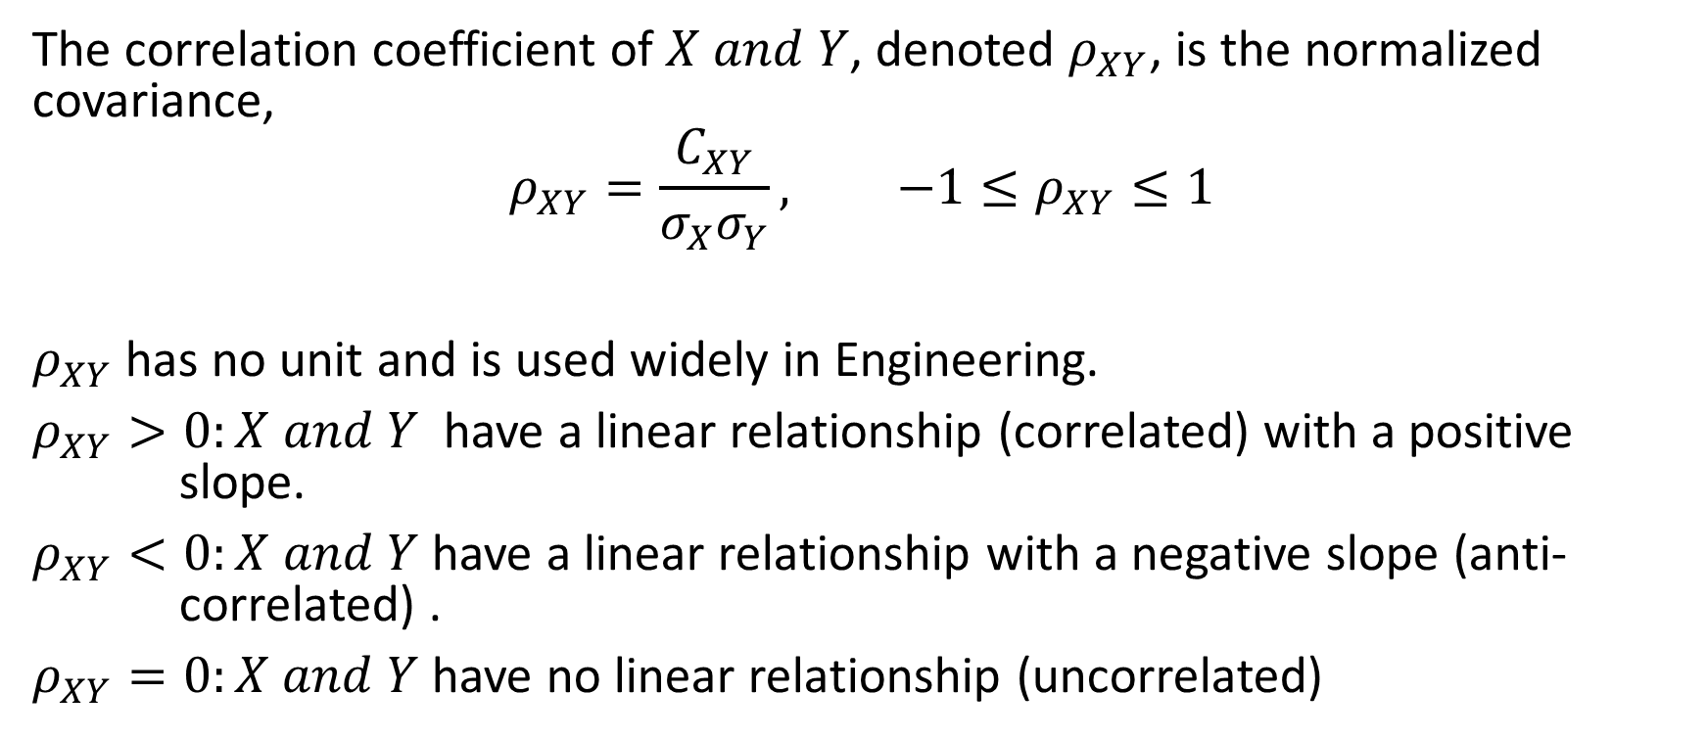
Correlation Coefficient
The correlation coefficient of $X and Y$, denoted $ρ_{XY}$, is the normalized covariance,
$$ρ_{XY}=\frac{C_{XY}}{σ_{X}σ_{Y}}, −1≤ρ_{XY}≤1$$
$ρ_{XY}$ has no unit and is used widely in Engineering.
$ρ_{XY}>0:X and Y$have a linear relationship (correlated) with a positive slope.
$ρ_{XY}<0:X and Y$have a linear relationship with a negative slope (anti- correlated) .
$ρ_{XY}=0:X and Y$have no linear relationship (uncorrelated)

Slide 40
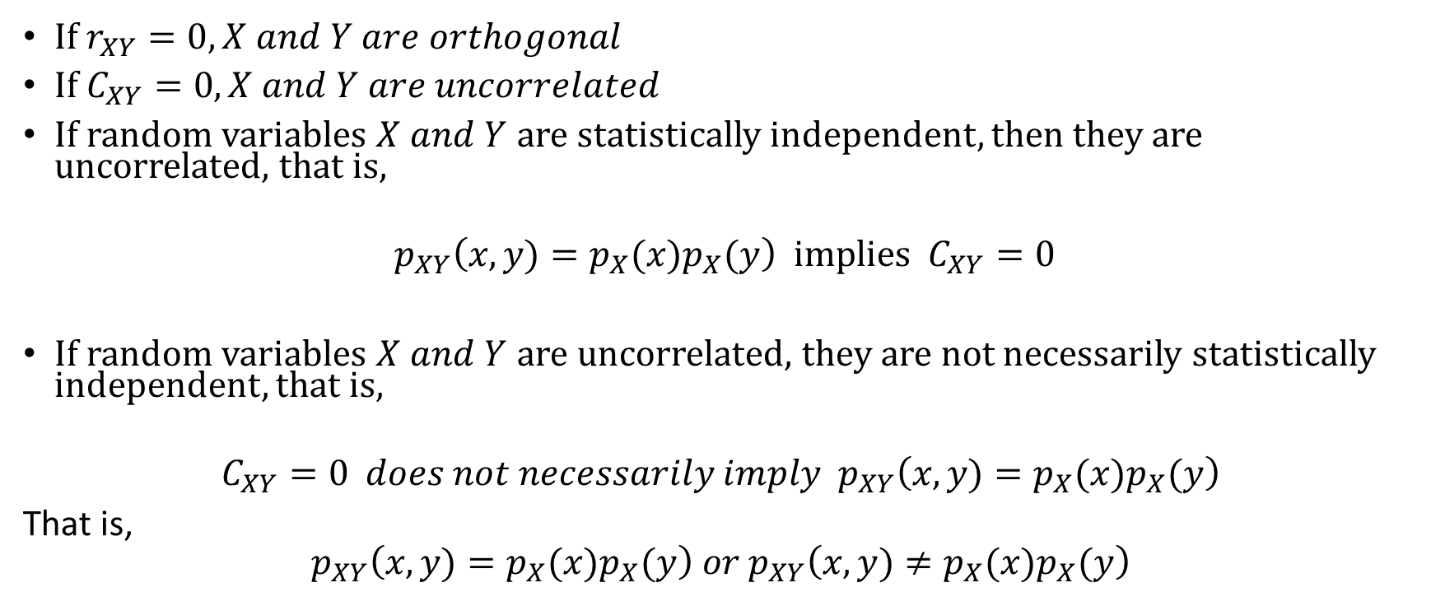
Statistical Independence versus Uncorrelatedness
If $r_{XY}=0, X and Y are orthogonal$
If $C_{XY}=0, X and Y are uncorrelated$
If random variables $X and Y$ are statistically independent, then they are uncorrelated, that is,
$$p_{XY}\left(x,y)=p_{X}(x)p_{X}(y\right) implies C_{XY}=0$$
If random variables $X and Y$ are uncorrelated, they are not necessarily statistically independent, that is,
$$C_{XY}=0 does not necessarily imply p_{XY}\left(x,y)=p_{X}(x)p_{X}(y\right)$$
That is,
$$p_{XY}\left(x,y)=p_{X}(x)p_{X}(y\right) or p_{XY}\left(x,y)≠p_{X}(x)p_{X}(y\right)$$

Slide 41
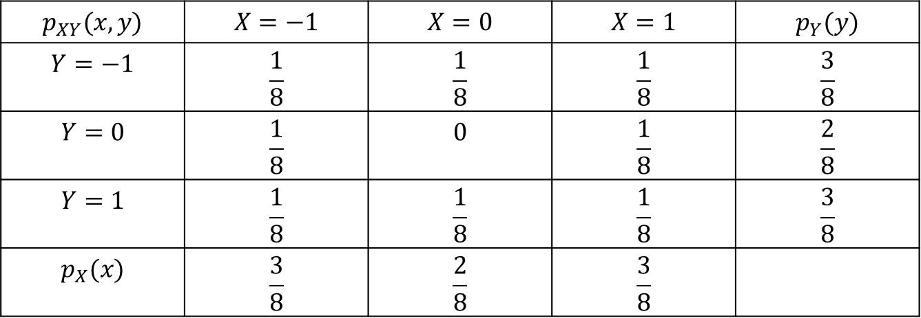

Example 10
For the joint PMF in the table below, we can show that the two random variables are uncorrelated ($C_{XY}=0$), but they are not independent, that is, $p_{XY}\left(x,y\right)≠p_{X}\left(x\right)p_{Y}\left(y\right)$.
$$p_{XY}(x,y)$$ | $$X=−1$$ | $$X=0$$ | $$X=1$$ | $$p_{Y}(y)$$
$$Y=−1$$ | $$\frac{1}{8}$$ | $$\frac{1}{8}$$ | $$\frac{1}{8}$$ | $$\frac{3}{8}$$
$$Y=0$$ | $$\frac{1}{8}$$ | $$0$$ | $$\frac{1}{8}$$ | $$\frac{2}{8}$$
$$Y=1$$ | $$\frac{1}{8}$$ | $$\frac{1}{8}$$ | $$\frac{1}{8}$$ | $$\frac{3}{8}$$
$$p_{X}(x)$$ | $$\frac{3}{8}$$ | $$\frac{2}{8}$$ | $$\frac{3}{8}$$

Slide 42
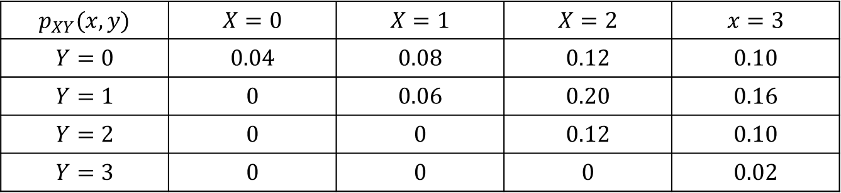

Example 11
A travel agent keeps track of the number of customers who call, and the number of trips booked on any one day. Let $X$ denote the number of calls, $Y$ the number of trips booked and $p_{XY}\left(x,y\right)$ their joint PMF. Records show the following:
Find the correlation coefficient $ρ_{XY}$
$$p_{XY}(x,y)$$ | $$X=0$$ | $$X=1$$ | $$X=2$$ | $$x=3$$
$$Y=0$$ | $$0.04$$ | $$0.08$$ | $$0.12$$ | $$0.10$$
$$Y=1$$ | $$0$$ | $$0.06$$ | $$0.20$$ | $$0.16$$
$$Y=2$$ | $$0$$ | $$0$$ | $$0.12$$ | $$0.10$$
$$Y=3$$ | $$0$$ | $$0$$ | $$0$$ | $$0.02$$

Slide 43
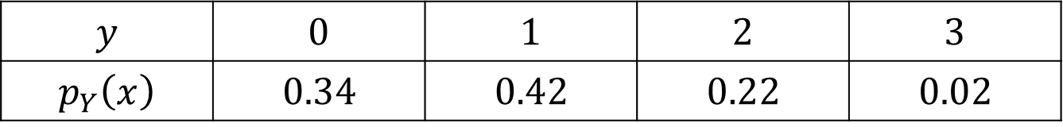
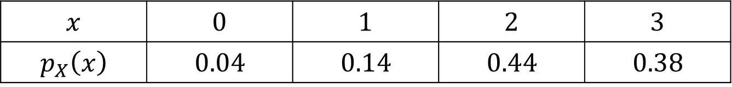
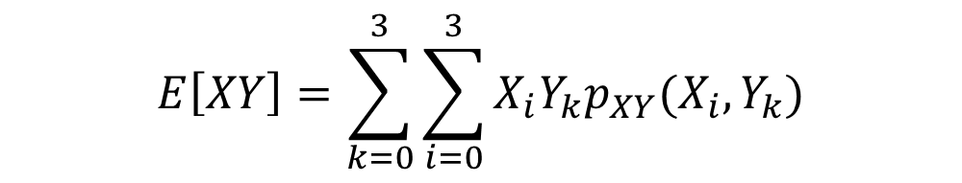
Example 11 Solutions
$$x$$ | $$0$$ | $$1$$ | $$2$$ | $$3$$
$$p_{X}\left(x\right)$$ | $$0.04$$ | $$0.14$$ | $$0.44$$ | $$0.38$$
$$y$$ | $$0$$ | $$1$$ | $$2$$ | $$3$$
$$p_{Y}\left(x\right)$$ | $$0.34$$ | $$0.42$$ | $$0.22$$ | $$0.02$$
$$μ_{X}=2.16$$ | $$μ_{Y}=0.92$$ | $$C_{XY}=0.2128$$ | $$σ_{X}^{2}=0.6544$$ | $$σ_{Y}^{2}=0.6336$$ | $$ρ_{XY}=0.33$$
$$E\left[XY\right]=\sum_{k=0}^{3}{\sum_{i=0}^{3}{X_{i}Y_{k}p_{XY}(X_{i},Y_{k})}}$$

Slide 44

Example 12
The fraction $X,$ of female runners and the fraction $Y,$ of male runners who compete in marathon races are described by the joint PDF
$$f_{XY}\left(x,y\right)=\left\{\begin{aligned}8xy, 0≤y≤x≤1 \\ &0, otherwise\end{aligned}\right.$$
Find the covariance and the correlation coefficient of $X and Y$.

Slide 45

Example 12 Solutions
First, find the marginal PDFs
$$f_{X}\left(x\right)=\int_{0}^{x}{8xydy=}\left\{\begin{aligned}4x^{3}, 0≤x<1, \\ &0, otherwise.\end{aligned} \right.$$
$$f_{Y}\left(y\right)=\int_{y}^{1}{8xydx=}\left\{\begin{aligned}4y\left(1−y^{2}\right), 0≤y<1, \\ &0, otherwise.\end{aligned}\right.$$
Next, compute the individual mean values
$$μ_{X}=\int_{0}^{1}{4x^{4}dx=\frac{4}{5}}, μ_{Y}=\int_{0}^{1}{4y^{2}\left(1−y^{2}\right)dy=\frac{8}{15}}$$

Slide 46


Example 12 Solutions
Use the joint PDF to compute the correlation
$$E\left[XY\right]=\int_{0}^{1}{\int_{y}^{1}{8x^{2}y^{2}dxdy=\frac{4}{9}}}$$
Compute the covariance
$$C_{XY}=E\left[XY\right]−μ_{X}μ_{Y}=\frac{4}{9}−\frac{4}{5}×\frac{8}{15}=\frac{4}{225}$$

Slide 47

Example 12 Solutions
Compute the standard deviations and the correlation coefficient
$$E\left[X^{2}\right]=\int_{0}^{1}{4x^{5}dx=\frac{2}{3}, E\left[Y^{2}\right]=\int_{0}^{1}{4y^{3}\left(1−y^{2}\right)dy=\frac{1}{3}, } }$$
$$σ_{X}^{2}=\frac{2}{3}−{\left(\frac{4}{5}\right)}^{2}=\frac{2}{75}, σ_{Y}^{2}=\frac{1}{3}−{\left(\frac{8}{15}\right)}^{2}=\frac{11}{225},$$
$$ρ_{XY}=\frac{4/225}{\sqrt{\left(2/75\right)\left(11/225\right)}}=\frac{4}{\sqrt{66}}=0.49$$

Slide 48

Sums of Random Variables
Mean and Variance of Sums of Two Random Variables
$$E\left[X±Y\right]=μ_{X}±μ_{Y}$$
$$Var\left(X+Y\right)=\left\{\begin{aligned}σ_{X}^{2}+σ_{Y}^{2}+{2C}_{XY}, X and Y dependent, \\ \\ &{ σ}_{X}^{2}+σ_{Y}^{2}, X and Y independent\end{aligned}\right.$$
$$Var\left(X+Y\right)=E\left[{\left(\left(X−μ_{X}\right)+\left(Y−μ_{Y}\right)\right)}^{2}\right]$$
$$Var\left(X+Y\right)=E\left[{\left(X−μ_{X}\right)}^{2}\right]+2E\left[\left(X−μ_{X}\right)\left(X−μ_{Y}\right)\right]+E\left[{\left(Y−μ_{Y}\right)}^{2}\right]$$
$$Var\left(X+Y\right)=σ_{X}^{2}+σ_{Y}^{2}+{2C}_{XY}$$

Slide 49

PDF of the Sum of Random Variables
Consider $n$ independent random variables ${\left\{X_{i}\right\}}_{i=1}^{n}$ with individual PDFs $f_{X_{i}}\left(x_{i}\right)$. It is desired to determine the PDF and the statistics of their sum
$$Y=\sum_{i=1}^{n}{X_{i}}$$
The best way to handle this is through the moment generating functions.

Slide 50

Moment Generating Functions
Single Random Variable: The moment generating function of a single random variable is defined as the expected value of the function $e^{uX}$
$$φ_{X}\left(u\right)=E\left[e^{uX}\right]=\int_{−∞}^{∞}{e^{uX}f_{X}\left(x\right)dx}$$
If we interpret the above as the inverse Fourier transform of the PDF $f_{X}\left(x\right)$, then the inverse Fourier transform of the moment generating function is the PDF of $X$,
$$f_{X}\left(x\right)=\int_{−∞}^{∞}{e^{−uX}φ_{X}\left(u\right)du}$$

Slide 51


First Moment of $X$
Expected value of $X$ (first moment):
Take the first derivative of the moment generating function,
$$\frac{dφ_{X}(u)}{du}=\int_{−∞}^{∞}{f_{X}\left(x\right)\frac{d\left(e^{ux}\right)}{du}dx=\int_{−∞}^{∞}{xf_{X}(x)e^{ux}dx}}$$
Evaluate the first derivative at $u=0$,
$${\left.\frac{dφ_{X}(u)}{du}\right|}_{u=0}=\int_{−∞}^{∞}{xf_{X}\left(x\right)dx=μ_{X}}$$

Slide 52

Higher Moments of 𝑋
Mean Square Value (2nd moment):
$${\left.\frac{d^{2}φ_{X}(u)}{du^{2}}\right|}_{u=0}=\int_{−∞}^{∞}{x^{2}f_{X}\left(x\right)dx=E\left[X^{2}\right]}$$
Higher Moments:
$${\left.\frac{d^{m}φ_{X}(u)}{du^{m}}\right|}_{u=0}=\int_{−∞}^{∞}{x^{m}f_{X}\left(x\right)dx=E\left[X^{m}\right]}$$

Slide 53

Moment Generating Functions
Bernoulli $Ber\left(p\right):$ $φ_{X} \left(u\right)=1−p+pe^{u}$
Binomial $Bin\left(n,p\right): φ_{X}\left(u\right)={\left(1−p+pu\right)}^{n}$
Discrete Uniform $\left(k,l\right):$ $φ_{X}\left(u\right)=\frac{e^{uk}−e^{u(l+1)}}{\left(l−k+1\right)\left(1−e^{u}\right)}$
Geometric $Geo\left(p\right): φ_{X}\left(u\right)=\frac{pe^{u}}{1−\left(1−p\right)e^{u}}$
Poisson $\left(λ\right):{ φ}_{X}\left(u\right)=e^{λ\left(e^{u}−1\right)}$
Exponential $\left(λ\right): φ_{X}\left(u\right)=\frac{λ}{λ−u}$
Gaussian $\left(μ_{X}, σ_{X}\right): φ_{X}\left(u\right)=e^{\left(uμ_{X}+u^{2}σ_{X}^{2}/2\right)}$
Continuous Uniform $\left(a,b\right):φ_{X}\left(u\right)=\frac{e^{bu}−e^{au}}{u\left(b−a\right)}$

Slide 54

Sum of Two Independent Random Variables
$Consider the sum of two independent random variables X and Y, Z=X+Y.$ Their moment generating function is
$$φ_{Z}\left(u\right)=E\left[e^{u\left(X+Y\right)}\right]=φ_{X}\left(u\right)φ_{Y}\left(u\right)$$
The moment generating function of the sum of two independent random variables is equal to the product of their individual moment generating functions

Slide 55

PDF of the Sum of Independent Random Variables
Using the Fourier transform analogy, the PDF of the sum is the convolution of the individual PDF’s, that is,
$$f_{Z}\left(x,y\right)=\int_{−∞}^{∞}{e^{\left(ux+uy\right)}φ_{X}\left(u\right)φ_{Y}\left(u\right)du=f_{X}(x)∗f_{Y}(y)}$$
In general, for $n$ independent random variables, $X_{1}, X_{2},…, X_{n},$ the PDF of their sum $Z=\sum_{i=1}^{n}{X_{i}}$, is the convolution of their individual PDFs,
$$f_{Z}\left(x_{1}, x_{2},…, x_{n}\right)=f_{1}\left(x_{1}\right)∗f_{2}\left(x_{2}\right)∗…∗f_{n}(x_{n})$$

Slide 56

The Central Limit Theorem
Let $\left\{X_{i}\right\}$ be $n$ independent random variables with arbitrary probability distribution functions and identical means and variances. Then, according to the central limit theorem, the distribution of their sum, converges to the Gaussian distribution as $n$ increases.
Consider the sum of $n$ independent random variables, ${\left\{X_{i}\right\}}_{i=1}^{n},$ with identical mean values and variances $μ_{X_{i}}=μ_{X} and σ_{X_{i}}^{2}=σ_{X}^{2} for ∀ i$
$$Z=\sum_{i=1}^{n}{X_{i}}$$
With increasing $n$, the sum approaches a Gaussian Random variable with mean and variance,
$$μ_{Z}=nμ_{X} and σ_{Z}^{2}=nσ_{X}^{2}$$

Slide 57

Central Limit theorem and the Standard Gaussian Distribution
Suppose we normalize the sum as
$$Y_{n}=\sum_{i−1}^{n}{\frac{\left(X_{i}−μ_{X}\right)}{\sqrt{n}σ_{X}}}$$
Then
$$μ_{Y_{n}}=0 and σ_{Y_{n}}^{2}=1$$
According to the central limit theorem, the normalized sum tends to the standard Gaussian distribution as $n increases$.
Remark: The central limit theorem is valid even if the random variables are not identically distributed.

Slide 58

Central Limit Theorem
Discrete Random Variables
$$Z=\sum_{i=1}^{n}{X_{i}}$$
$$f_{Z}\left(x_{1}, x_{2},…, x_{n}\right)=f_{1}\left(x_{1}\right)∗f_{2}\left(x_{2}\right)∗…∗f_{n}(x_{n})$$

Slide 59

Central Limit Theorem
Continuous random
Variables
$Z=\sum_{i=1}^{n}{X_{i}}$
$f_{Z}\left(x_{1}, x_{2},…, x_{n}\right)$
$=f_{1}\left(x_{1}\right)∗f_{2}\left(x_{2}\right)∗…∗f_{n}(x_{n})$

